Slide 1


Slide 2

WOODWORKING DESIGN AND FABRICATION 2
WOODWORKING DESIGN AND FABRICATION 2

Slide 3
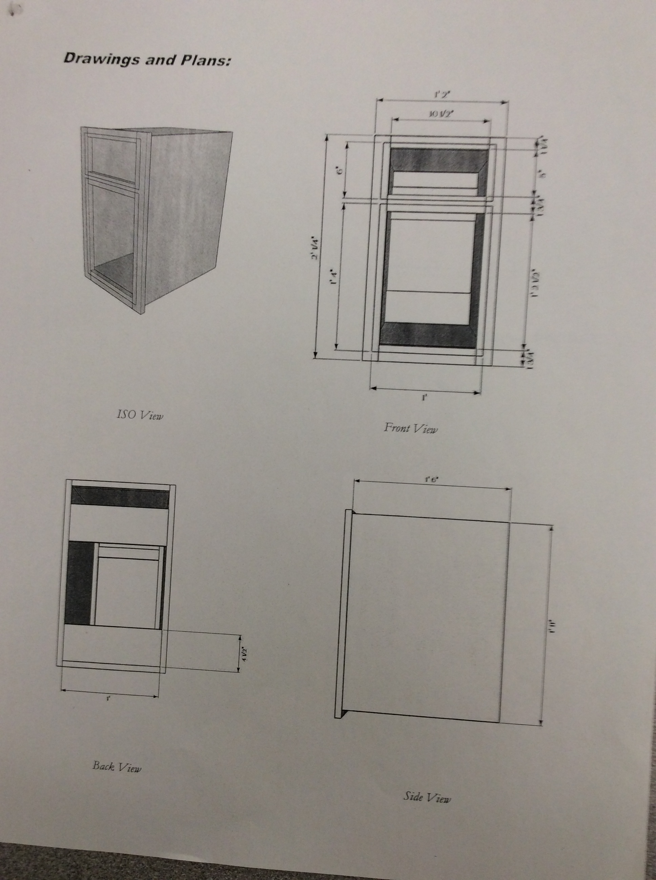

Slide 4
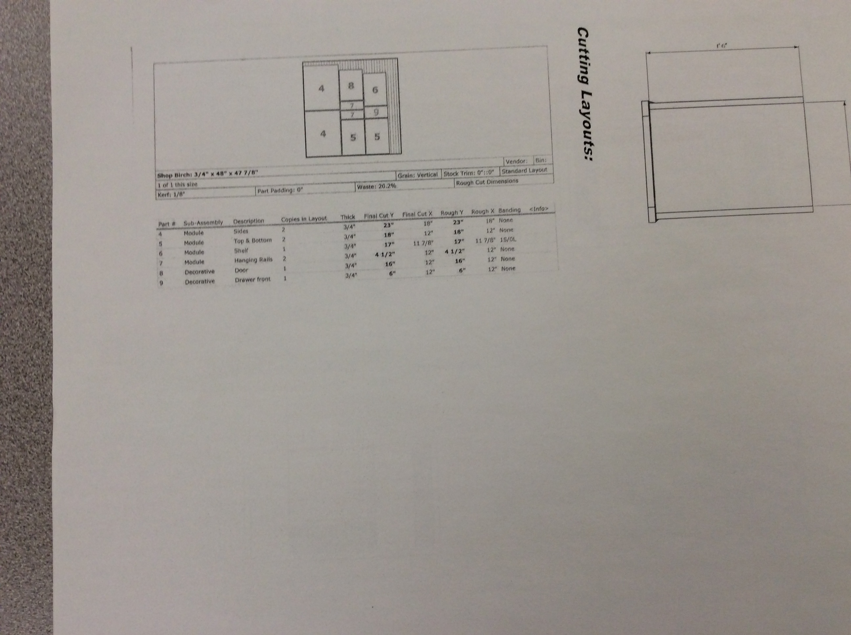

Slide 5
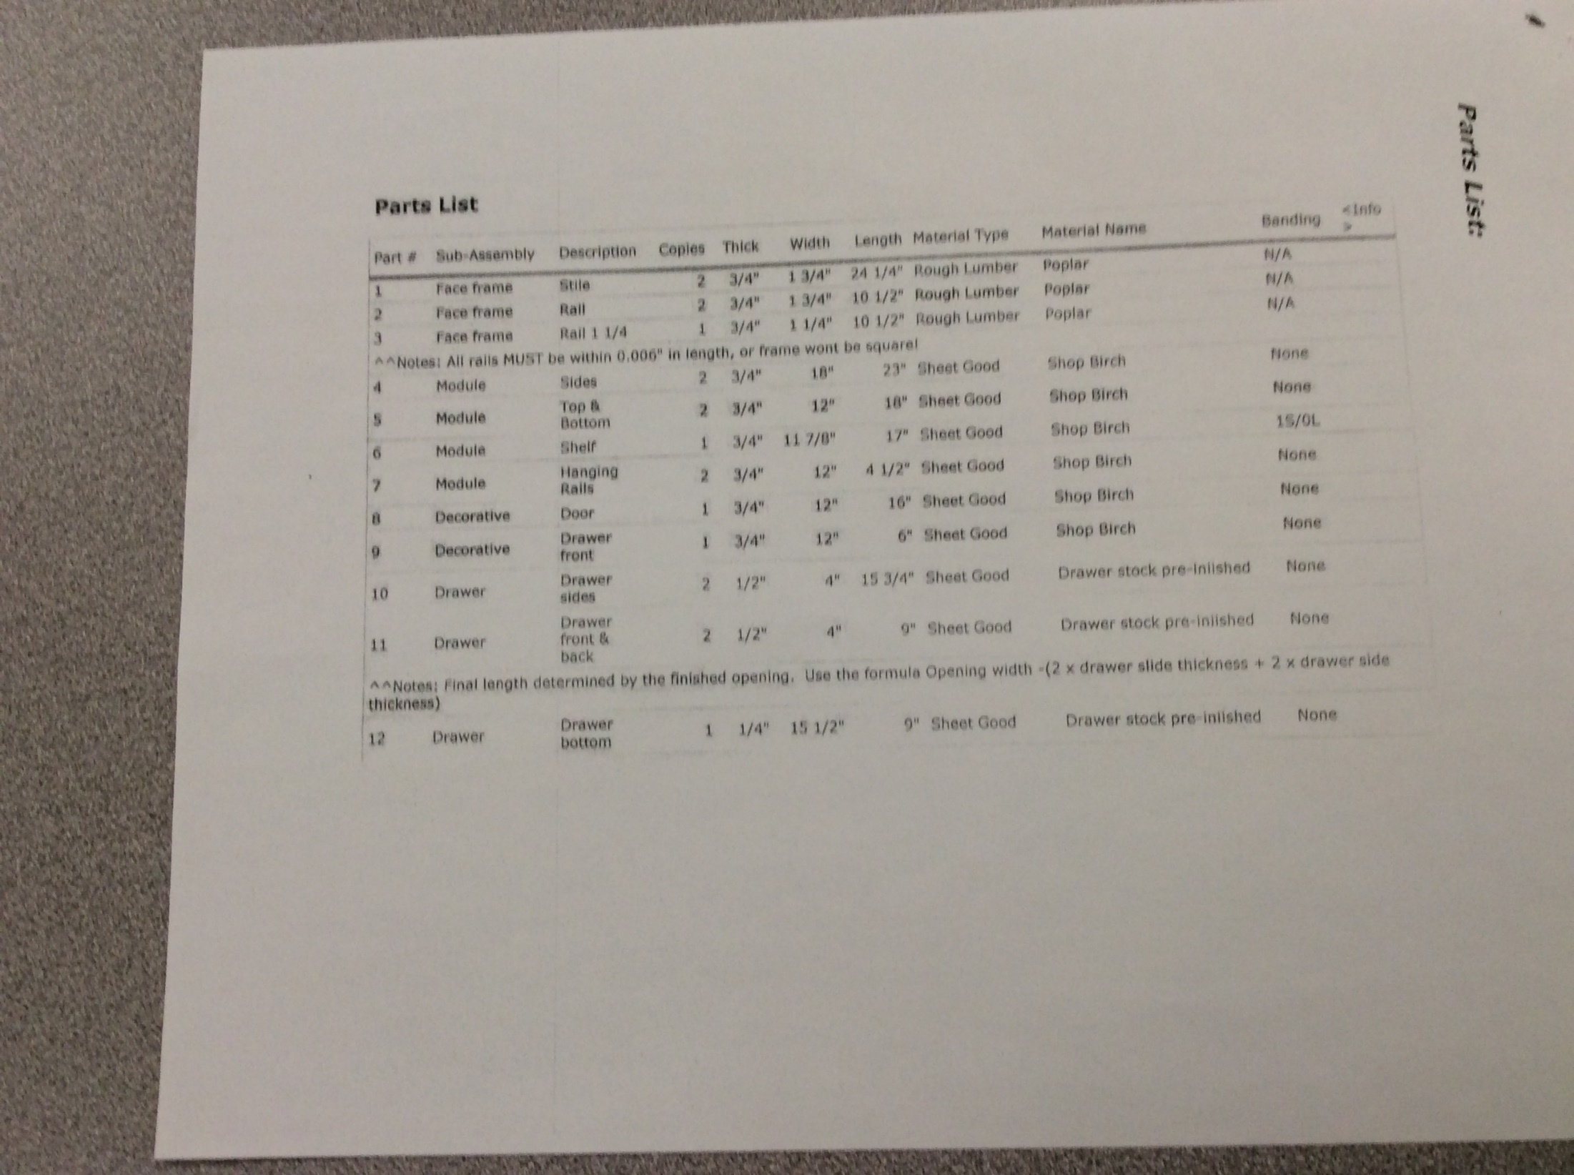

Slide 6
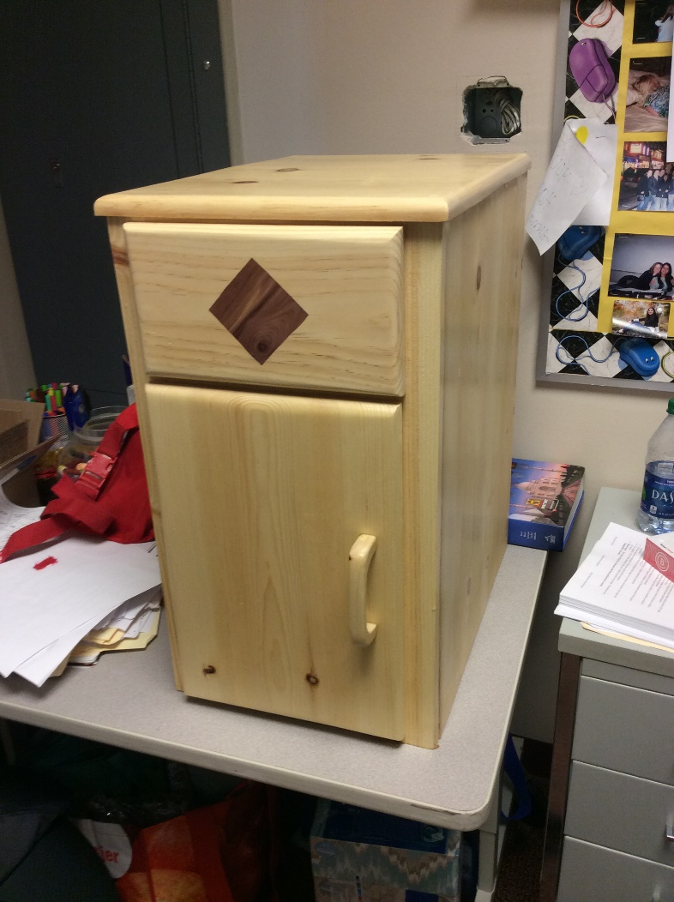
CABINET

Slide 7
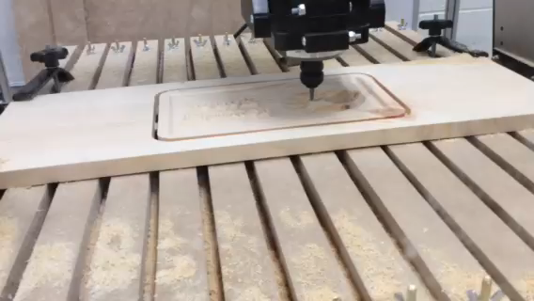

Slide 8
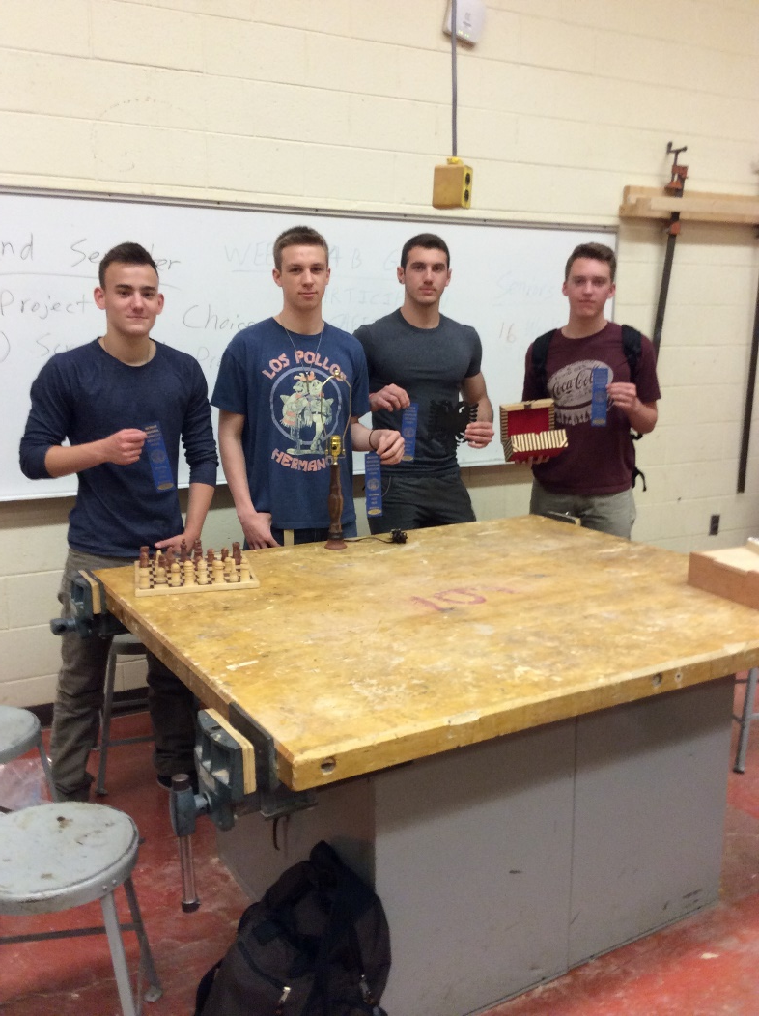
STUDENT CHOSEN PROJECTS AND M.I.T.E.S. (MICHIGAN INDUSTRIAL TECHNOLOGY EDUCATION SOCIETY) STUDENT COMPETITION

Slide 9
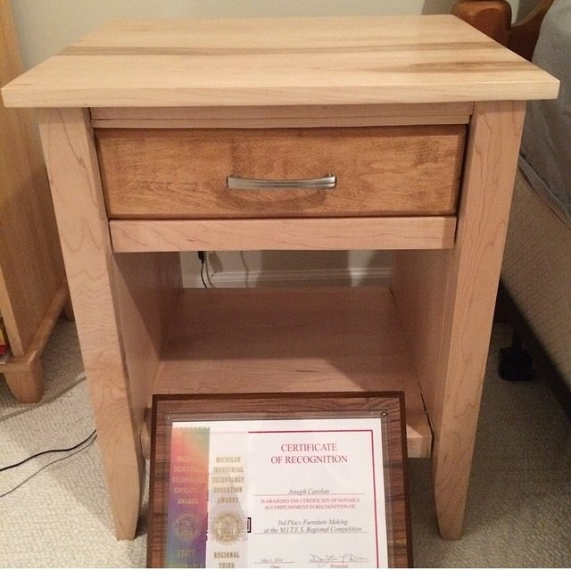
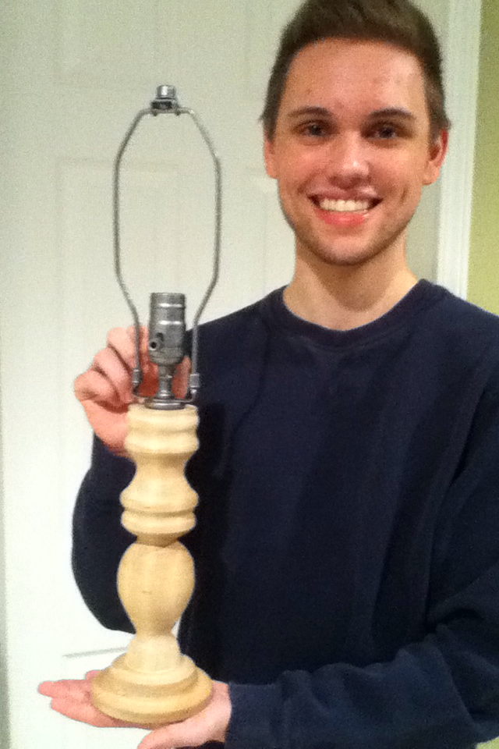
M.I.T.E.S.

Slide 10
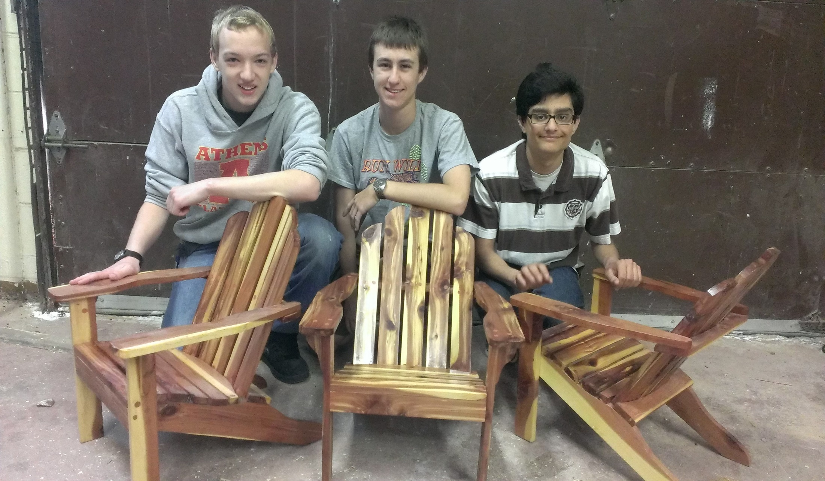
M.I.T.E.S.

Slide 11
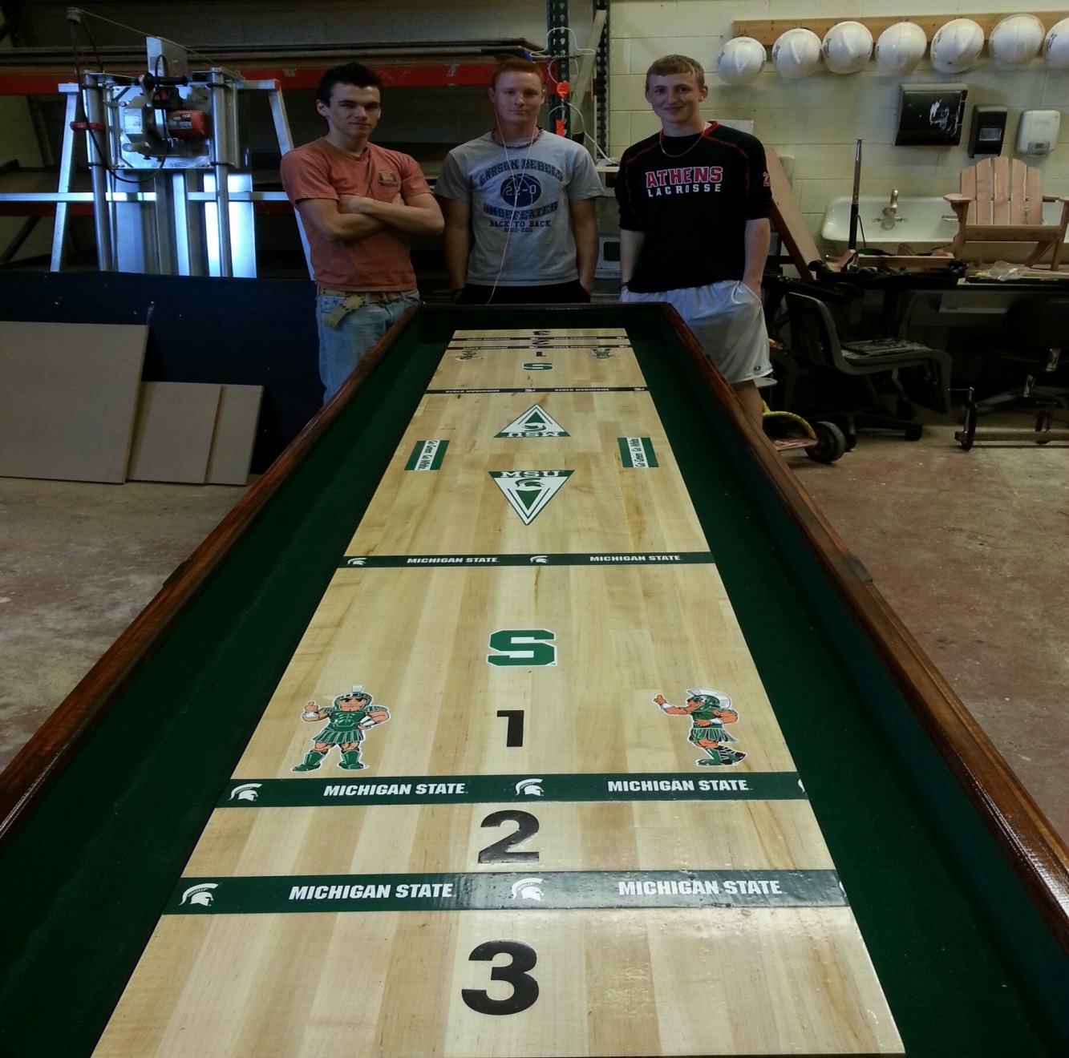
M.I.T.E.S.

